Slide 1
Baseline Standards and Taxonomies
Larry Cooper
MaxSys Consulting
Notes:
My name is Larry Cooper and I am a Consultant with MaxSys Consulting here in Ottawa.
My area of investigation revolved around Baseline Standards and Taxonomies.
As we all know, no discussion on standards would be complete with the proverbial statement that….

Slide 2
The wonderful thing about standards is…

Slide 3
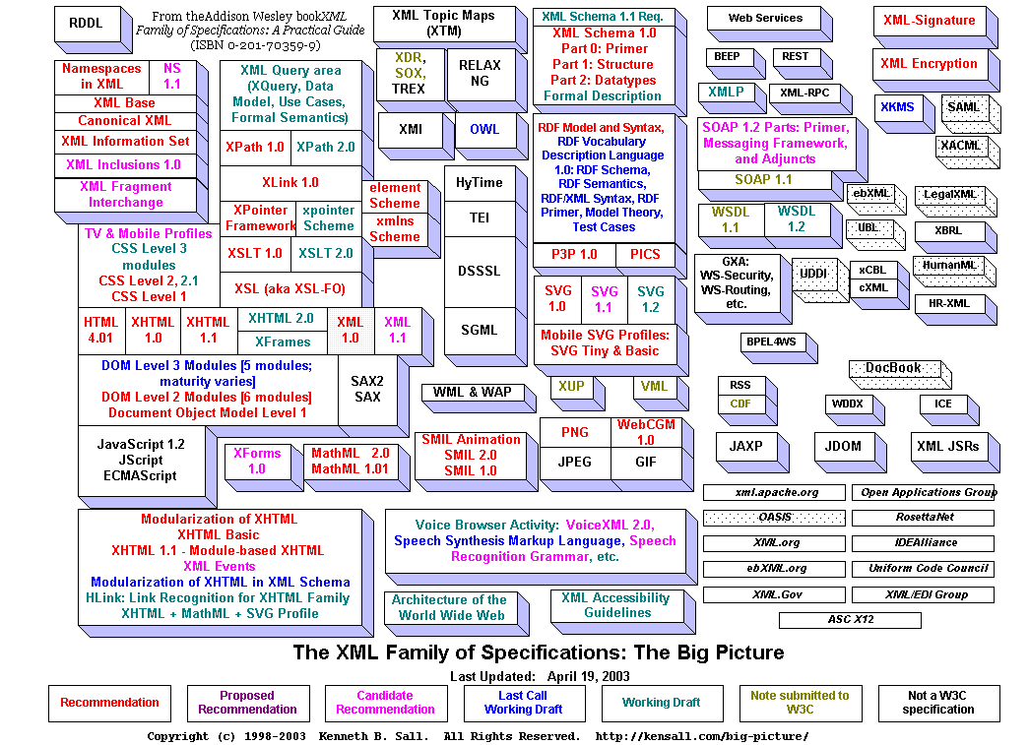
There are just so many to pick from!
Notes:
There are currently 450+ XML “Standards” and Specifications
Some standards and specifications are written more for the vendor community than they are for business users or even developers in some cases. They are the basis upon which developer tools are built.
Example from traditional IT Standards world:
Standard: IDEF1X
Question: What is it for?
Answer: It’s defines the symbology and methodology behind entity-relationship modeling tools such as ERWin.
XML Spy provides an integrated software development suite that encompasses XML, XSLT, XPath, Namespaces, XML Schema, SOAP, WSDL, P3P
Need to focus on the ones that have the biggest business impact – those that facilitate interoperability pan-GoC and with GoC partners while respecting privacy and security concerns

Slide 4
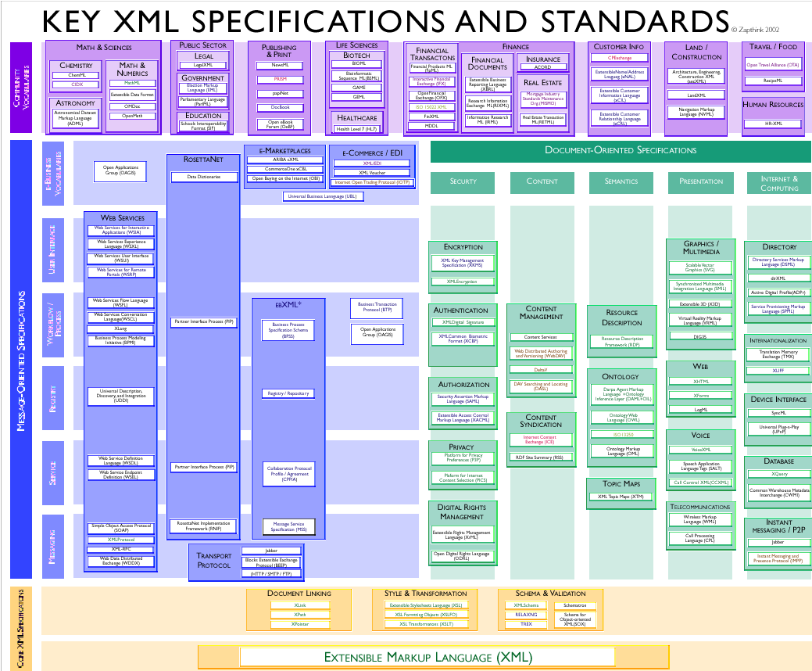
And so many ways to organize them!
Notes:
The take away from this diagram are the four categories that are used to classify the key XML standards and specifications:
Core XML Specifications - bottom
Message-Oriented Specifications – middle left
Document-Oriented Specifications – middle right
Community Vocabularies – top
We’ll come back to this diagram a bit later.
Source for above diagram: http://www.oasis-open.org/committees/download.php/173/xml%20standards.pdf

Slide 5
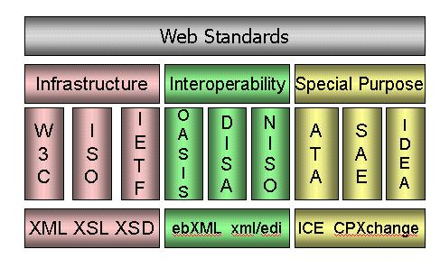
And so many players who define them!
Notes:
And there are lots of players involved in their creation – not to mention the different governments, businesses, vendors, and individuals!
SOURCE: IDEAlliance http://www.idealliance.org/XMLRoadmap/WEB/xmlstdill.htm#N1

Slide 6
Standards
and
Specifications

Slide 7
Container Versus Content Standards
Content Standards
Container Standards
Notes:
Recalling our earlier classification diagram, we can further categorized XML standards and specifications into two essential categories, that of container and content standards. While the diagram is a bit dated in some of the standards, most notably the web services space, having been produced in 2002, it is still useful in how it organizes the XML standards and specifications.
This classification system was developed as part of another effort that I participated in at the old CCRA with Greg Fox of the Enterprise Architecture division. Thanks Greg.

Slide 8
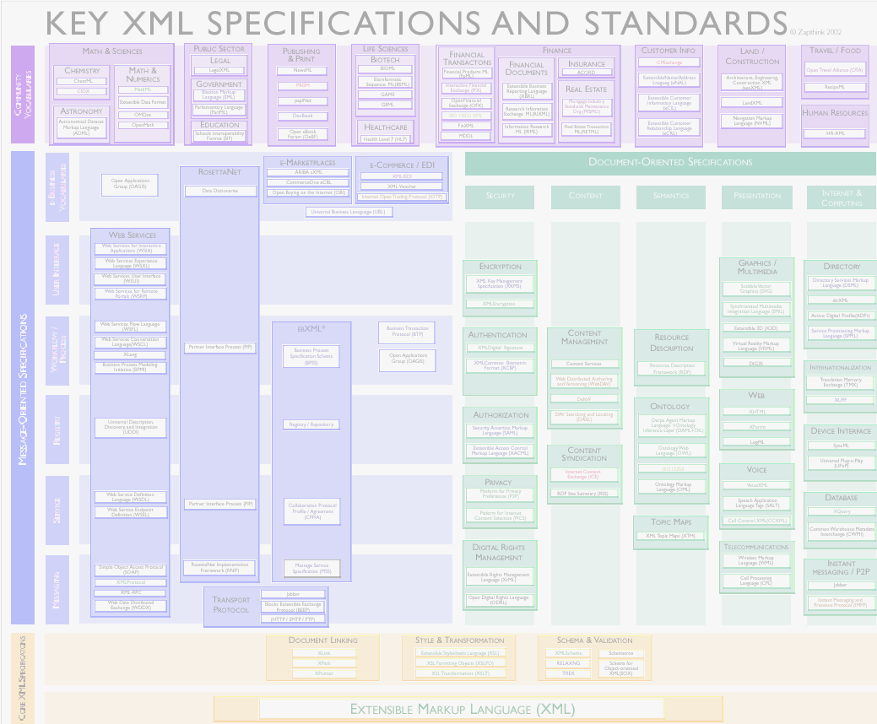
Container vs. Content Standards
Container Standards:
  mostly technical XML-based standards that are created to assist with a variety of information processing activities (eg. XSLT, XML Encryption, ebMS, etc.):
    Core XML Specifications
    Message Oriented Specifications
    Document-Oriented Specifications
Mostly the domain of the technical staff – the Technology layer
Varies in Maturity from being W3C notes (low maturity) to being implemented in tools for more than 2 years (very mature).
Container Standards
Notes:
Container standards are mostly technical in nature. As such they are the domain of the IM/IT Specialists. While many of the standards are very mature, having been around for a couple of years and already well ensconced in vendor tool offerings, others are just being defined and making their way through the W3C, OASIS, and other standards setting organizations.

Slide 9
Container Standards
Core XML Standards
  Document Linking
  Style & Transformation
  Schema & Validation
Message-Oriented Standards
  Messaging
  Service
  Registry
  Workflow/Process
  User Interface
  e-Business Vocabularies
Document-Oriented Standards
  Security
  Content
  Semantics
  Presentation
  Internet & Computing
Notes:
This shows the three main categories of Container Standards. As Container Standards are the domain of the IM/IT specialists we do not make specific recommendations.
However it did become rather obvious during out investigation that you cannot say you are adopting XML as an organization and not recognize that certain of the container standards must be accepted by default. EG: ISO 11179 which underlies much of XML itself, XLink, XPath, SOAP, etc.
An example of how we need to look at Container Standards is to look to Entity-Relationship (or Data) Modelling. Few people realize that it is based on a standard called IDEF1X from FIPS in the US. Most of us know that we have tools like ERWin that allows us to build our ER Diagrams.
Hopefully, in the not too distant future, many of the XML Container Standards will meet the same fate as IDEF1X – that of relative anonymity.
Core XML Standards
Document Linking (XLink, XPath, XPointer)
Style & Transformation (XSL, XSL-FO, XSLT)
Schema & Validation (XML Schema, SOX)
Additional Core Standards (ISO 11179, XML Namespaces, XInclude, XML Infoset)
Message-Oriented Standards
Messaging (SOAP, ebMS, HTTP/SMTP/FTP, (transport))
Service (CPP/A, WSDL)
Registry (ebXML Registry/ Repository, UDDI)
Workflow/Process (BPSS, BPEL4WS)
User Interface (Needs investigation)
e-Business Vocabularies (Not applicable)
Document-Oriented Standards
Security (** Must be sync’d with Secure Channel and other GoC security)
Encryption (XML Encryption, XKMS)
Authentication (XML Digital Signature)
Authorization (SAML, XACML)
Privacy (P3P)
Digital Rights Management (XrML)
Content (RSS, Dublin Core)
Semantics (RDF)
Presentation (SVG, XHTML, XForms, LogML, WML)
Internet & Computing (DSML, XQuery)

Slide 10
Content Standards
Content Standards
Content Standards:
  Define business information. These are the mark-up languages that help specif business domains:
    Vertical industries
    Communities
    User groups
  Application neutral and community independent
Mostly the domain of the business-line Subject Area Experts – the Information layer.
Mostly low in Maturity or just starting, though some are considered very mature.
Notes:
Content Standards are what you use to define your business information. So while Container Standards are the domain of IM/IT, Content Standards are the domain of the business Subject Area Experts.
This is no different than in today’s relational database world – while the IM folks are the data modellers as they understand the modelling tools, it is in fact the business subject area experts that actually define the business data itself and as well the descriptions that go with it.
As with Container Standards, many of the Content Standards are very mature, having been around for a couple of years and already well ensconced in vendor tool offerings, others are just being defined and making their way through the W3C, OASIS, and other standards setting organizations.

Slide 11
Content Standards
Classification
Core Components
Context
Artifact
Notes:
Content standards can be viewed from the following four different but related perspectives:
Classifications are way of grouping like concepts. An example of classification system is a taxonomy. CPSIN is a classification system for IJI data. GSRM is also a classification system.
Core Components help to define specific concepts in a way that are semantically correct. Within CPSIN we will see a Core Component called Person.
Context establishes specific circumstances in which Core Components can be used. For the Core Component Person, we can have multiple contexts such as Suspect, Witness, Parolee, Victim, etc. When a Core Component is used in a real business circumstance (a context) it serves as the basis for a “Business Information Entity” (BIE).
Context categories include the following: Roles Context, Business Process Context, Product Classification Context, Industry Classification Context, Geopolitical Context, and System Capabilities Context
An Artifact is a specific instance of a model, schema, or process that has been constructed using Core Components from a classification within a specific context. While technology exists (e.g., Registries / Repositories) to store artifacts, mechanisms to manage artifacts, especially in a government-wide environment, need to be developed.
A taxonomy is a classification according to a pre-determined system. This results in a catalogue used to provide a conceptual framework for discussion, analysis or information retrieval. In Web portal design, taxonomies are often created to describe categories and subcategories of topics found on the Web site. The Statistics Canada site “Browse by subject” feature is an example of a taxonomy.

Slide 12
Why do Standards?
Facilitates creation of Smart Data:
  Ownership Characteristics
    Established through Legislation, policies, etc.
  Roles and Privileges
    Who can access/update it?
    Linked to Privilege Management Infrastructure
  Life Cycle Management
    Audit trails: who accessed it? Who updated it?
    Retention and archiving policies
    Etc.
  Actual Business Data
Notes:
So why should we do standards anyway?
Recall at the beginning of this morning’s session the quote from GSRM? The world of information in government is complex and it is becoming more so. In order to recognize and deal with all that complexity, we need to understand what affects that information.
Also, recall that in earlier presentations, Andrew Robinson introduced the concept of the information supply chain, and Suhayl Masud introduced the concept of Smart Data and the need for a registry/repository for effective management of that data.
Realizing that governments are in the information business, utilizing a conceptual framework like the “information supply chain” can be a powerful first step towards the creation of smart data. So what do we mean by “Smart Data”?
Within the GoC, Smart Data is envisioned as the mechanism by which we create a framework where we can know under what auspices we are allowed to collect information about persons, both domestic and foreign (Ownership), who is allowed to access that information and for what purpose (Roles and Privileges), what has happened to that information throughout its life (Life Cycle), and what was the information actually collected (Business Data).
Smart Data, then, when developed in the context of an information supply chain, is a way for the GoC to manage process complexity.
Within each of these four categories, we will need to define what metadata is required in order to begin the process of creating Smart Data.
Initial investigation has been started on the Privilege Management Infrastructure (PMI) but will not be reported on today. What has been done so far is to look at privilege management in the contexts of data, roles, and processes.

Slide 13
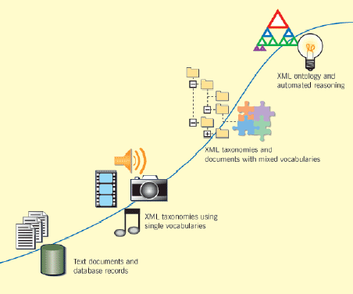
Smart Data Does not Just Happen
Source: The Semantic Web
IJI is here
We are here
Notes:
But Smart Data does not just happen by itself nor will it happen overnight.
Mostly, our data is at the text document and database level today.
IJI is moving towards XML taxonomies. Clearly, a lot has to be done before we have made even one area of our data “smart” – let alone all of it.
The Semantic Web, as envisioned by Tim Berners-Lee who also invented the web itself, and what will get us to the light bulb at the top right, clearly is still a ways off. But it will happen.
It is usually not the business drivers inside an individual organization that drives business transformation but rather those that put pressures on it from the outside.
The need to share information with your partners is a very compelling reason for looking at and adopting XML and all of the benefits and challenges that go with that decision. This was also born out in the traditional supply chain world where initiatives like RosettaNet and e2open have experienced widespread and rapid adoption due to their ability to demonstrate value propositions, that were in no small way significantly influenced by the ability to define and share information using XML.

Slide 14
Standards and Strategy Recommendations
Notes:
Finally, let’s turn our attentions to the standards and strategy recommendations.

Slide 15
Service Output Types & XML
For each GSRM output type there is an XML Schema built using core components
Each schema can be classified as applying to different communities such as:
  GoC
  Sector or Community of Interest
  Departments
  Etc.
Facilitates re-use, efficiency, understanding and information interchange
Notes:
As mentioned by Dan Demos earlier, GSRM defined 19 output types. For each output type there needs to be an XML Schema built using core components as the building blocks which may in turn lead to the creation of additional core components.
Each of these schema can also be classified according to the different communities of interest (COI) to which they belong. Each COI is of course context specific.
Converting the GSRM output types into XML schema and further by having them classified by COI will facilitate reusability and enable easier information interchange within the GoC and between the GoC and its partners. But in order to achieve re-use you must first be able to find that which already exists – the registry/repository presentations this morning and the demos this afternoon will highlight some of the ways in which re-use can be achieved.
As an example of the what we mean by this, lets take look at the service output type of “Funds”. We would first need to create an XML Schema that captures the characteristics of Funds that are common across all areas of potential usage for the Funds service type within the GoC. In building the common schema, the BTEP program would re-use core component that have been already developed as part of CPSIN such as Person Name and Address, etc. They might also need to re-use the ISO geography codes, and NAICS industry codes.
A specific COI (or Program Field in the GSRM terminology) , say Economic Development, would then use the common Schema and extend it to meet its own specific needs. For example, in extending that common Schema for funds transfer for environment-related projects, additional core components and schema fragments might have to be developed for windmill generated power capabilities. If certificates or permits had to be issued before a fund could be approved, metadata describing the particular certificate might have to be added to funds issued under a specific departmental program contributing to environment-friendly economic developments. This type of extension could be relevant to a specific program only and should be excluded from the GoC and COI schemas.
It is easy to see that as we progress through the development of new XML Schema for each service output type, that less and less is being built from scratch, and that re-usability is indeed becoming a reality.

Slide 16
Reality Check
Implementing XML, in the absence of a standards strategy, presents risks/challenges:
  Risk that redundant data definitions, vocabularies, and structures will proliferate
  Potential for proprietary extensions to be built into systems that would defeat XML’s goal of broad interoperability
  Potential for new security vulnerabilities to be introduced in existing systems and networks
  GoC-wide strategy for XML adoption must be defined to guide implementation efforts and ensure that enterprise architectures address incorporation of XML
  XML interoperability across the GoC depends on an effective cross-department registry/repository of XML data structures that systems developers can consult when building or modifying XML-based systems
  Information plus process interoperability is made more difficult, more expensive, longer to implement, harder to maintain
An integrated suite of standards, management processes for both container and content standards, support and promotion of standards processes, methodologies and their tools as well as a registry/repository is needed
Notes:
Implementing XML will neither be without risk nor without its challenges. This list constitutes but some of the risks and challenges and hence is not meant to be definitive.
Interoperability across the GoC depends on an effective cross-departmental registry/repository that systems developers can consult when building or modifying XML-based systems. Without such a registry/repository, it will be difficult to achieve the level of interoperability that is required, and indeed expected, as if you unable able to find that which already exists, you are apt to re-create it.
But a registry/repository by itself is not a silver bullet. You also need an integrated suite of standards, you need management processes for both the container and content standards arenas, and you need to fully support and promote standards process, methodologies and their supporting tools. Setting up IM Centre’s of Excellence is one such method of providing support.

Slide 17
Operational Strategy
Re-use content standards where they exist
  “In-use” XML must be made visible/accessible
    XML component re-use should be facilitated
    Need open, participatory XML Configuration Control processes
Extend where necessary
  Conflicting XML should be avoided
    Overlapping terms/definitions impede horizontal integration
    Namespace concept can be used to ensure tag uniqueness
Create and contribute where nothing exists
Notes:
Any operational strategy must address both tactical and strategic requirements.
Tactically, we need to ensure that we re-use what we already have, extend it where necessary, and create and contribute new standards only where nothing exists.

Slide 18
Operational Strategy
Selection Precedence for Content Standards
  International
  Pan-Canadian
  GoC
  Community of Interest
  Department (or program specific)
Standards Extension/Creation
Standards Adoption
Notes:
Strategically, we need to ensure that a proper selection precedence exists for bringing in or defining new Content Standards as they are the ones over which we have the most control.
This will also serve to provide a focus for how Canada contributes to international standards.
If we look at the precedence top down we see how we will decide which standards to adopt and when to define new ones.
Example Top Down: The e-Learning metadata standards for the GoC were derived from the international IEEE standard for Learning Object Metadata (IEEE 1484.12.1-2002) and Dublin Core (ISO). They then looked at the Pan-Canadian standard CanCore, and finally at GoC guidance, to derive the e-learning Community of Interest metadata recommendations for the GoC. These standards, with GoC adaptations, are now being implemented by Departments. DND, RCMP, and CCMD are also working collaboratively on guidance specific to their environments.
If we look from the bottom up we see the sequence for how we would contribute to the creation of new standards.
Example Bottom Up: DND’s Advanced Distributed Learning (ADL) Partnership Lab for Canada is a key contributor to the Shareable Content Object Reference Model (SCORM) e-learning standard. The work that they have done has made its way into extending the international SCORM standard through their participation in international committees.
So this precedence hierarchy is real today and does work as illustrated by these two examples.

Slide 19
Strategy Recommendations
Implement a Governance Model for both Container and Content standards and plan to evolve them over time
Implement support and promotion mechanisms (i.e. IM CoE )
Identify and facilitate communities of practice such as IJI to develop and use common content standards
Continue with pathfinder projects that validate standards processes, tools, strategies and tactics
Tie new projects’ funding to use of Content and Container Standards
Tie use of Container and Content Standards to the MAF and performance measurement
Notes:
The list of six recommendations you see here are again not necessarily all that could have been provided. But they do constitute what we believe to be the key recommendations, that if implemented, will significantly enhance our ability to meet the IM e-Enabler project objectives and indeed those of the government at large as well.
First, we turn to the issue of governance. To adapt a well know phrase, “governance isn’t everything, it’s the only thing!” We need to implement a governance model for both Container and Content standards but with the recognition that as we gain experience, it will need to evolve to capture the lessons of that experience such that our governance model remains relevant and effective over time.
We need support and promotion mechanisms like IM CoE’s. An example might be one that supports Information Architects in schema and metadata development. Another area of support and promotion that seems obvious would be with respect to the registry/repository. Other areas of expertise also need to be identified and appropriately supported. This will not only support the areas of expertise themselves, but also significantly enhance the effectiveness of the governance model through tangible support mechanisms.
The TBS has already made effective use of pathfinder projects on the IM e-Enabler project such as you will see this afternoon with the Registry/Repository demo. That process needs to continue and our view expand to cover all relevant areas of IM e-Enablers.
Funding for new projects through the TBS must be tied to how these projects can demonstrate their planned use of Container and Content Standards. Moreover, also tying such standards usage to the Management Accountability Framework and performance management, will be the first steps towards expeditious and efficient take-up.

Slide 20
Issues Needing to be Addressed
Alignment with Current Standards in the GoC
Integration with Partner IM Standards
GoC Department/Program
Funding
Policies/guidance for operations and maintenance
Policies/guidance for use
Training – what and how to deliver (traditional classroom based versus e-learning versus hybrid)
Reference Models/Architectures
Compliance – testing and validation
Evolution of standards and approaches
Notes:
Implementing these recommendations will not be accomplished without also addressing a host of issues like the ones you see here.
Alignment of Container and Content Standards with existing standards within the GoC and vice versa, how they will be integrated with partner IM Standards, as well as across departments and programs are rather obvious ones. And it is also rather obvious they these are squarely focused in effective governance.
Addressing the funding question.
Support and promotion through effective and relevant policies, guidance, and training also loom large. Saying that such things will be implemented across the GoC have enormous implications of geography – you will not be able to deliver all of the necessary training in traditional classrooms due to cost and time factors. The Canada School of Public Service would seem like an obvious choice for this project to partner with in determining the best mix of e-learning and traditional classroom training. DND’s ADL Partnership Lab is also a resource that should be examined in this regard, as the adoption of an XML-based standard like SCORM for the development of learning modules that can be re-used, as well as research that they are conducting in learning content management, could both be quite beneficial to the GoC as it moves further into its adoption of XML.
The development and promotion of reference models and architectures like the Government Services Reference Model will prove critical to any success that is experienced. As well using compliance testing and validation to ensure that any tools, methodologies or processes that are adopted, and indeed adapted, to meet the needs of the public service environment in which they must be used. We saw a great example of that adaptation earlier in how the GSRM extended the Zachman framework to use public sector relevant terminology and processes.
And we must always recognize that these standards and our approaches to how we will adopt and adapt them will need to evolve. That which we hold true today, may not be so tomorrow, as the objectives and priorities of the government and its stakeholders also evolve.
Thank you for attention.

